Slide 1
CS310 Operating Systems Lecture 5: Process – PCB, System Calls
Ravi Mittal
IIT Goa

Slide 2
Acknowledgements !
Contents of this class presentation has been taken from various sources. Thanks are due to the original content creators:
CS162, Operating System and Systems Programming, Profs. Natacha Crooks and Anthony D. Joseph, University of California, Berkeley
Book: Operating Systems: Three Easy Pieces, by Remzi and Andrea Arpaci-Dusseau
Chapter 5: Process APIs
Book: The Operating System Concepts, third edition: Silberschatz, Peter Galvin, Greg Gagne,
CS 423 Operating System Design, Uinv of Illinois, Prof Fagen-Ullmschneider
CS 423 Operating System Design, Uinv of Illinois, Prof Fagen-Ullmschneider

Slide 3
Read the following:
Book: Operating Systems: Principles and Practice (2nd Edition) Anderson and Dahlin
Volume 1, Kernel and Processes
Chapter 2: Kernel Abstraction
Book: Operating Systems: Three Easy Pieces, by Remzi and Andrea Arpaci-Dusseau
Chapter 5: Process APIs

Slide 4
We will study..
Last Class - Revision
Process State
Process Control Block
Process Scheduling
Process APIs and System Calls - Introduction

Slide 5
Last Class

Slide 6
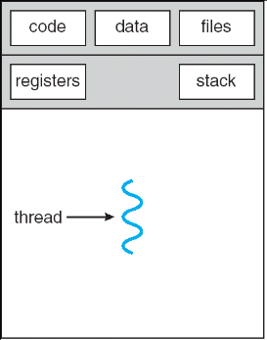
Recall: Process
A unique Identifier (PID)
Memory Image
Code and Data (Static)
Stack and Heap (Dynamic)
CPU Context
Registers
PC
Stack Pointer
Frame Pointer
General Purpose Registers
File Descriptors
Pointers to open files and devices
Single-Threaded Process

Slide 7
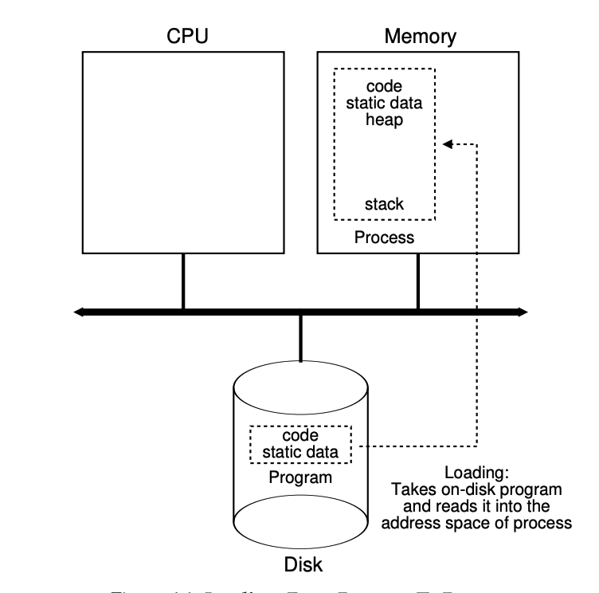
Recall: Process Creation
Allocates memory and creates memory image
Loads code, static data from disk executable (eg a.out)
Creates and initialized runtime stack and heap
Opens basic files
Standard Input, Output, Error
Standard Input Output let programs read input from terminal and print output to screen
Initializes CPU registers
PC points to first instruction
In modern OS, process loading is done lazily

Slide 8
Process States

Slide 9
Process States
Running
It is executing instructions
Ready
A process is ready to run; Yet to be scheduled
Waiting (blocked)
Suspended
Waiting for some event to be completed
Processes has initiated an I/O request to disk and gets blocked
As a process executes, it moves from state to state
Operating Systems Principles and Practice: Anderson and Dahlin

Slide 10
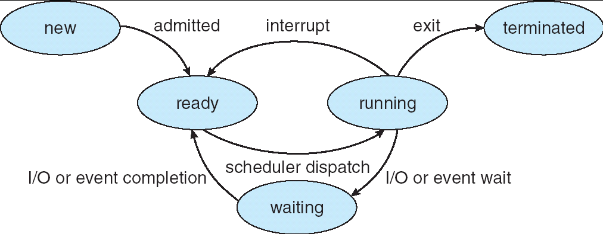
Lifecycle of a Process
As a process executes, it changes state:
new: The process is being created
ready: The process is waiting to run
running: Instructions are being executed
waiting: Process waiting for some event to occur
terminated: The process has finished execution

Slide 11
Process States
Time | Process 0 | Process 1 | Notes
1 | Running | Ready
2 | Running | Ready | Proc 0 initiates I/O
3 | Blocked | Running | Proc 0 is blocked; Proc 1 running
4 | Blocked | Running
5 | Ready | Running | Proc 0 I/O done
6 | Ready | Running | Proc 1 now done
7 | Running | - | Proc 0 is running
8 | Running | - | Proc 0 is now done

Slide 12
Process Control Block

Slide 13
Process Control Block: OS Data Structure
Operating system keeps track of various processes on a computer using Process Control Block (PCB)
PCB stores all the information the OS needs about the process
The OS allocates a new PCB on the creation of each process and places it on a state queue
The OS deallocates the PCB when the process terminates
PCBs are dynamically allocated in OS memory
User process can not access it

Slide 14
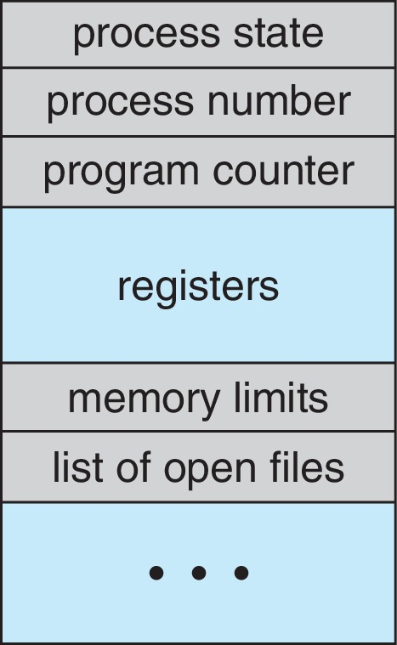
Process Control Block (PCB) - 1
Information associated with each process
Process state – running, waiting, etc.,
Program counter – location of instruction to next execute
Stack pointer (user stack ; Kernel stack)
CPU registers – contents of all process-centric registers
CPU scheduling information- priorities, scheduling queue pointers
Memory-management information – memory allocated to the process
Pointers to text, stack and heap segments
Page table related info
Process Identification – process id (pid), Parent process id (ppid), user id (uid),
Accounting information – CPU used, clock time elapsed since start, time limits
I/O status information – I/O devices allocated to process, list of open files
Book: The Operating System Concepts: Silberschatz, Galvin, Gagne

Slide 15
Process Control Block (PCB) - 2
Data Structuring: pointers to other PCBs
Process Privileges: Access privileges to certain memory area, critical structures etc
Resource ownership
Pointer to opened files etc
PCBs need to be protected from inadvertent destruction by any routine
Protection of PCBs is a critical issue in the design of an OS
Book: The Operating System Concepts: Silberschatz, Galvin, Gagne

Slide 16
PCB Fields

Slide 17
State Queues Examples

Slide 18
PCB and Context Switching
The process of switching the CPU from one process to another (stopping one and starting the next) is the context switch
The current state of process held in a process control block (PCB):
This is a “snapshot” of the execution and protection environment
Only one PCB active at a time
One one process is ”running” at a time
The OS starts executing a ready process by loading hardware registers (PC, SP, etc) from its PCB
While a process is running, the CPU modifies the Program, Counter (PC), Stack Pointer (SP), registers, etc.
When the OS stops a process, it saves the current values of the registers, (PC, SP, etc.) into its PCB
Time sharing systems may do 100 to 1000 context switches a second.

Slide 19
Process Scheduling

Slide 20
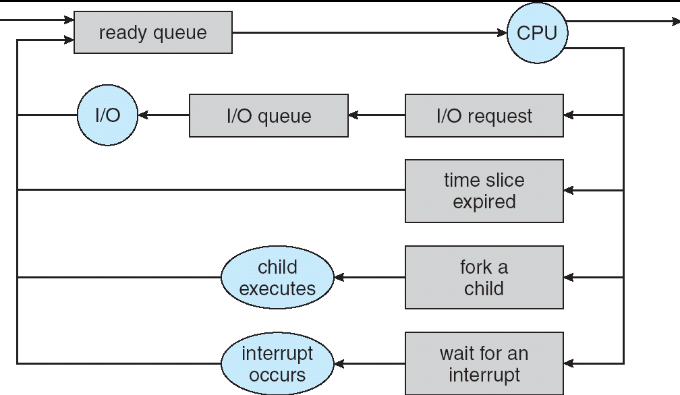
Process Scheduling
PCBs move from queue to queue as they change state
Decisions about which order to remove from queues are Scheduling decisions
Many scheduling algorithms possible (will study a few algos)
Book: The Operating System Concepts: Silberschatz, Galvin, Gagne

Slide 21
Ready Queue And Various I/O Device Queues
Process not running ⇒ PCB is in some scheduler queue
Separate queue for each device, condition (ready, wait etc)
Each queue can have a different scheduler policy
Ready
Queue
Head
Other
State
PCB₉
Link
Other
State
PCB₆
Link
Other
State
PCB₁₆
Link
Tail
Registers
Registers
Registers
USB
Unit 0
Head
Tail
Disk
Unit 0
Head
Other
State
PCB₂
Link
Other
State
PCB₃
Link
Tail
Registers
Registers
Disk
Unit 2
Head
Tail
Other
State
PCB₈
Ether
Netwk 0
Link
Head
Tail
Registers
Kubiatowicz CS162 © UCB Spring 2021

Slide 22
Process APIs and System Calls - Introduction

Slide 23
Process APIs
What interface should the OS present for process creation and control?
How should these interfaces be designed to enable?
Powerful functionality
Ease of use
High Performance

Slide 24
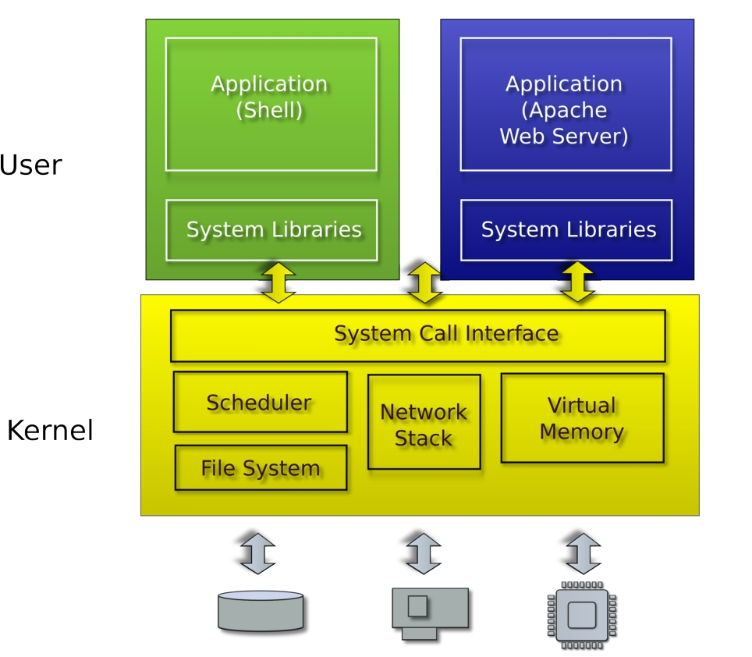
Typical Unix OS

Slide 25
System Calls (“Syscalls”)
Word Processing
Compilers
Web Browsers
“But, I’ve never seen a syscall!”
OS library issues system call
Language runtime uses OS library…
Email
Databases
Web Servers
Application / Service
Portable OS Library
User
System Call
Interface
OS
System
Portable OS Kernel
Software
Platform support, Device Drivers
Hardware
x86
PowerPC
ARM
PCI
Ethernet (1Gbs/10Gbs)
802.11 a/g/n/ac
SCSI
Graphics
Thunderbolt
Crooks & Joseph CS162 © UCB Spring 2021

Slide 26
OS Library Issues Syscalls
Proc 1
Proc 2
Proc n
…
OS
Appln
login
Window Manager
…
libc
OS library
OS library
OS library
OS
Crooks & Joseph CS162 © UCB Spring 2021

Slide 27
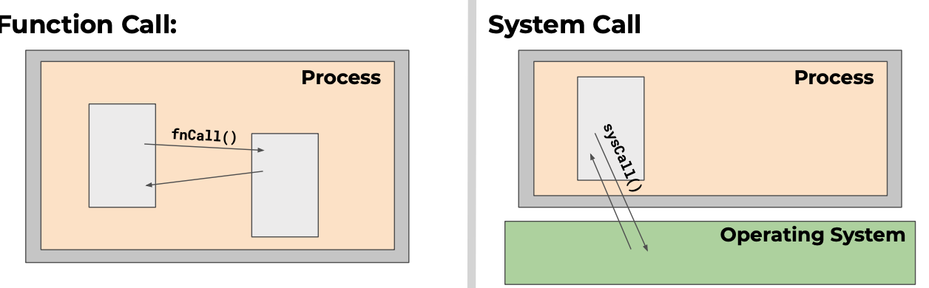
Function Calls vs System Calls
Caller and callee in the same process
Same user
Same “domain of trust”
OS is trusted; User process is not
OS code runs privileged with complete access to all system resources
CS 423 Operating System Design, Uinv of Illinois, Prof Fagen-Ullmschneider

Slide 28
System Calls
API : Application Programming Interface
Function available to write user programs
System calls are the interface of the OS for
Processes
Creating, existing, waiting, and terminating
Memory
Allocation and deallocation
Files and Folders
Opening, reading, writing, closing
Inter Process Communication
We will study process system calls in later lectures

Slide 29
Lecture Summary
Program in execution is a process
A process in execution moves from one state to another
Running, Ready, Waiting states
An important OS data-structure for multiprogramming/context switching is Process Control Block (PCB)
Each process has a PCB which contains all information about the process
There are many queues of PCBs which OS Kernel uses for scheduling
Ready Queue
Device Queue
Event Queue ..

